Slide 1
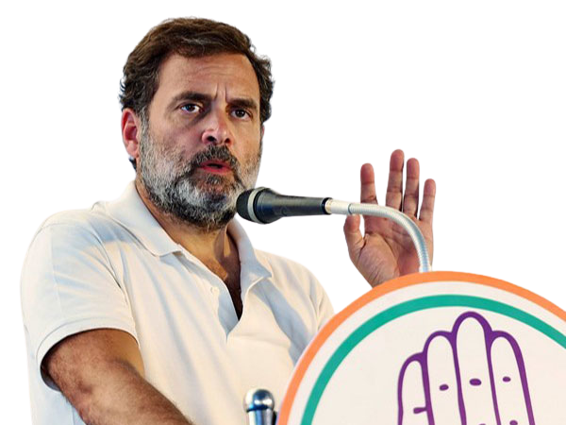
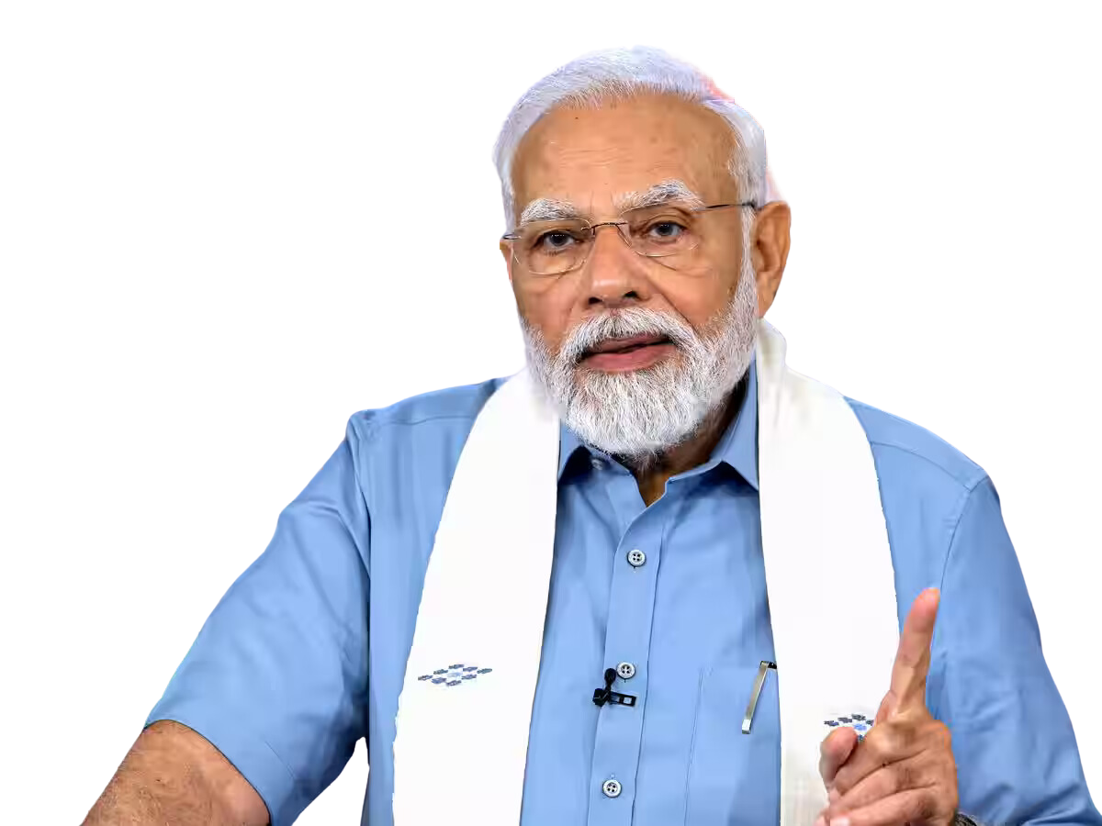
VS
INDIA GENERAL ELECTIONS
RESULT ANALYSIS 2024
FAROOK MOHAMMAD

Slide 2
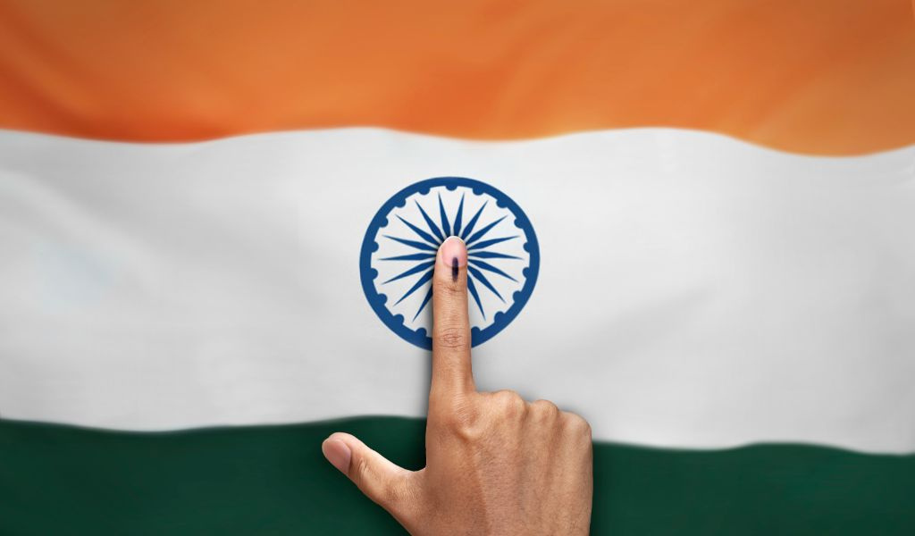
WELCOME
"Welcome to the India General Elections 2024 Result Analysis.
In this presentation, we will explore key trends, voter behavior, and significant outcomes.
Let’s dive into the data to understand the election's impact on India's future."
INDIA GENERAL ELECTIONS
RESULT ANALYSIS 2024

Slide 3


ABOUT ME
FAROOK MOHAMMAD
Farook Mohammad is a skilled Data Scientist with a passion for problem-solving and innovation. He is currently working as a Full Stack Developer at Datadynamx Pvt. Ltd. and has 1 year and 7 months of hands-on experience. Farook specializes in both front-end and back-end technologies, seamlessly integrating his expertise in development and data science. His work reflects a commitment to leveraging technology for impactful solutions.

Slide 4
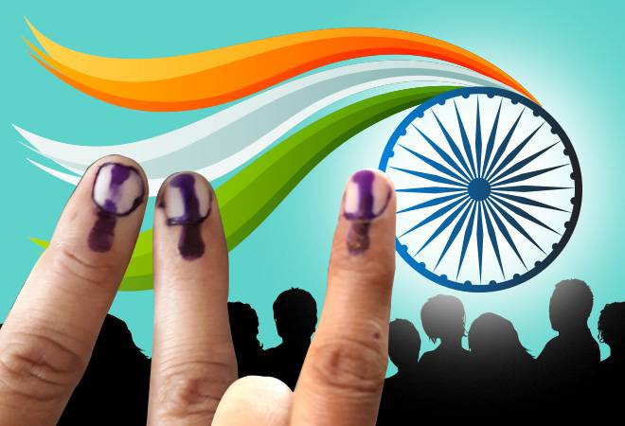
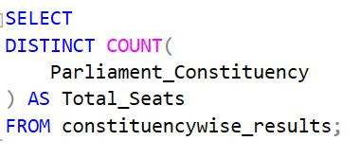
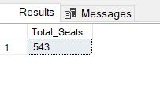
1. TOTAL SEATS
Query
Result

Slide 5
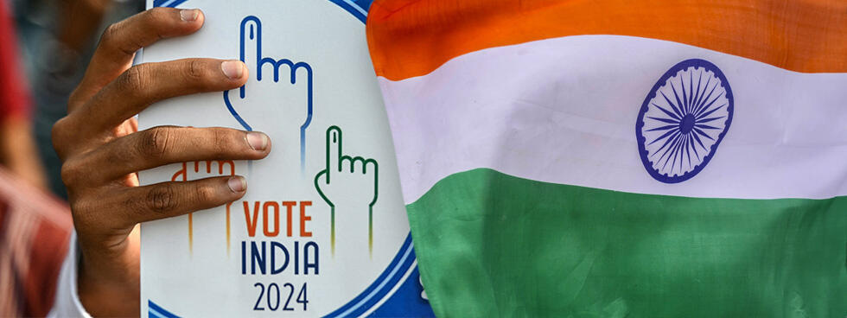
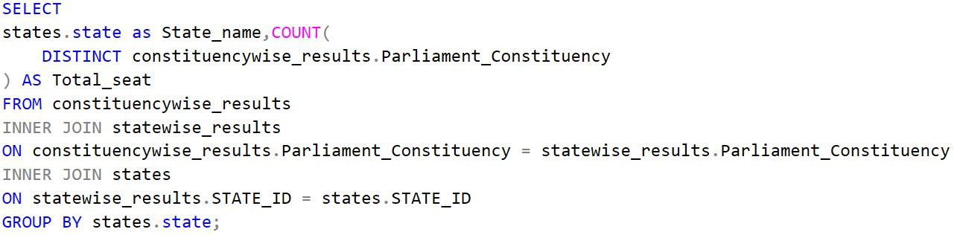
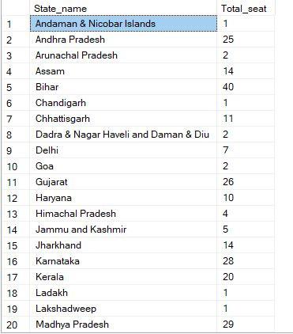
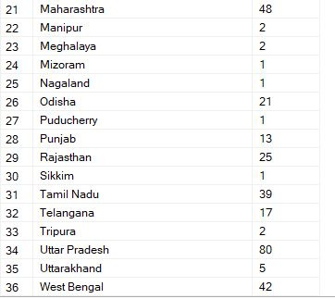
2. WHAT ARE THE TOTAL NUMBER OF SEATS AVAILABLE FOR ELECTIONS IN EACH STATE
Query
Result

Slide 6
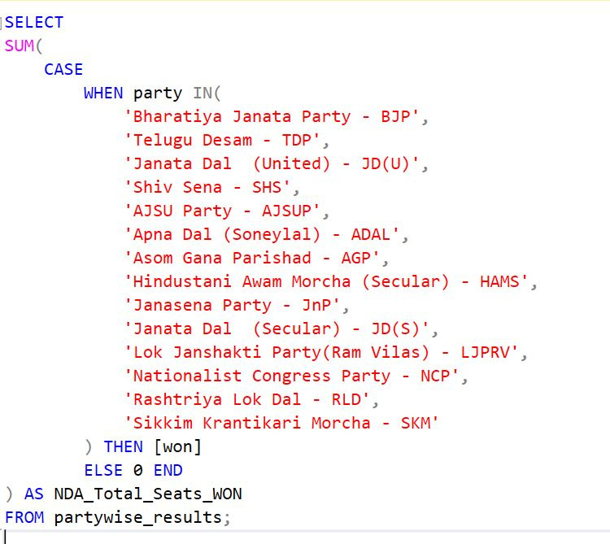
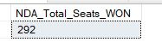
3. TOTAL SEATS WON BY NDA ALLIANCE
Query
Result

Slide 7
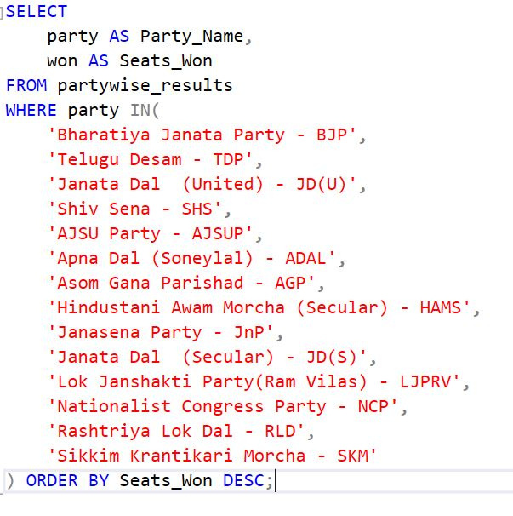
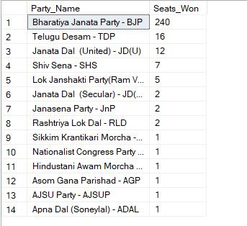
4. SEATS WON BY NDA ALLIANZ PARTIES
Query
Result

Slide 8
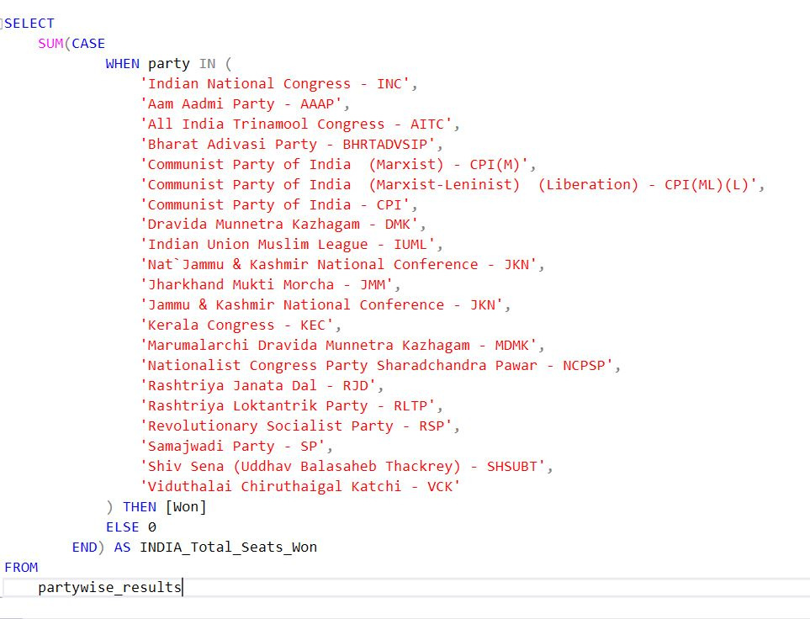
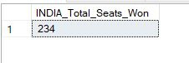
5. TOTAL SEATS WON BY I.N.D.I.A. ALLIANZ
Query
Result

Slide 9
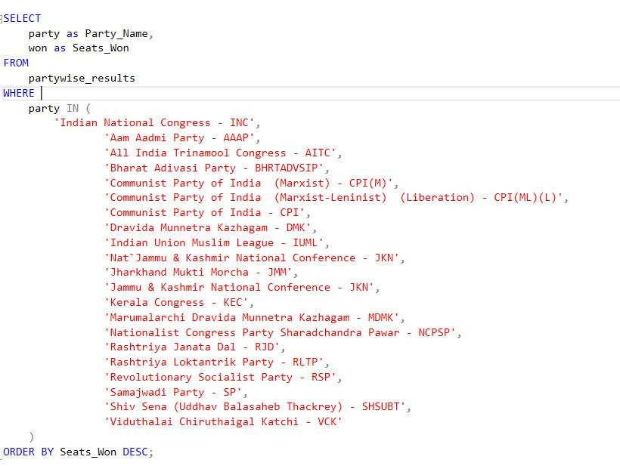
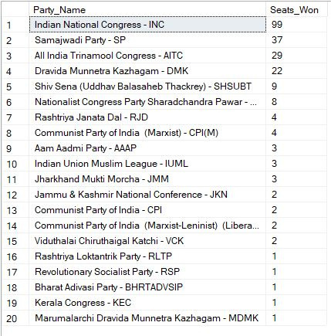
6. SEATS WON BY I.N.D.I.A. ALLIANZ PARTIES
Query
Result

Slide 10
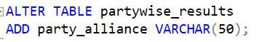
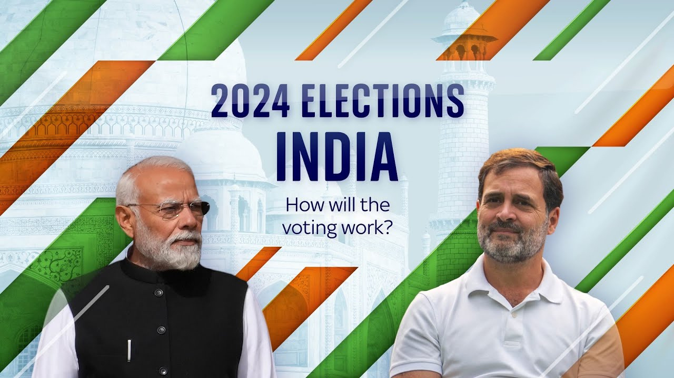

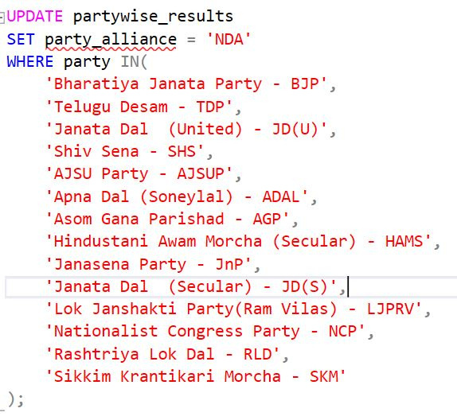
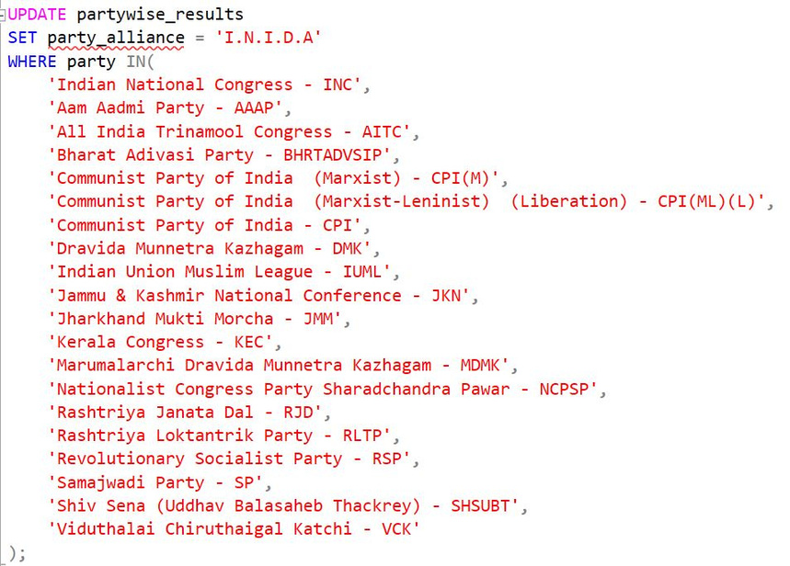
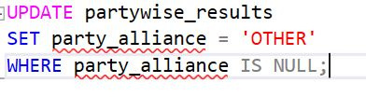
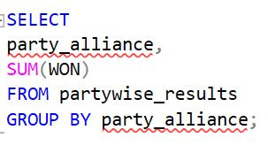
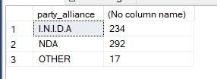
7. ADD NEW COLUMN FIELD IN TABLE PARTYWISE_RESULTS TO GET THE PARTY ALLIANZ AS NDA, I.N.D.I.A AND OTHER
Query

Slide 11
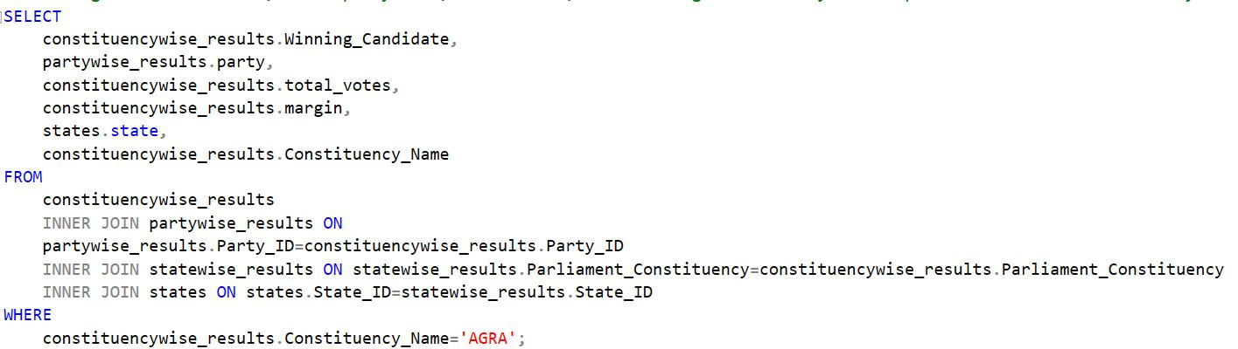
8. WINNING CANDIDATE'S NAME, THEIR PARTY NAME, TOTAL VOTES, AND THE MARGIN OF VICTORY FOR A SPECIFIC STATE AND CONSTITUENCY?
Query
Result

Slide 12
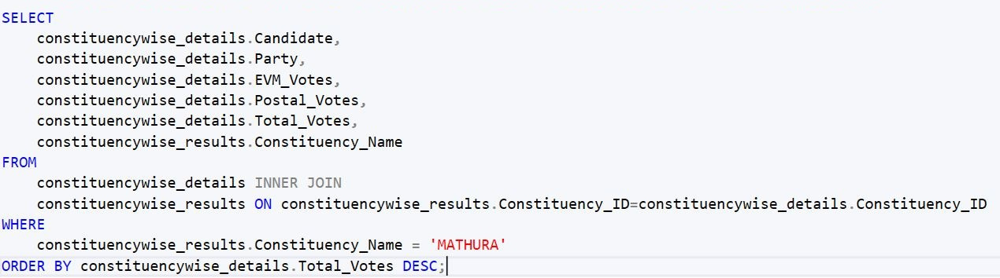
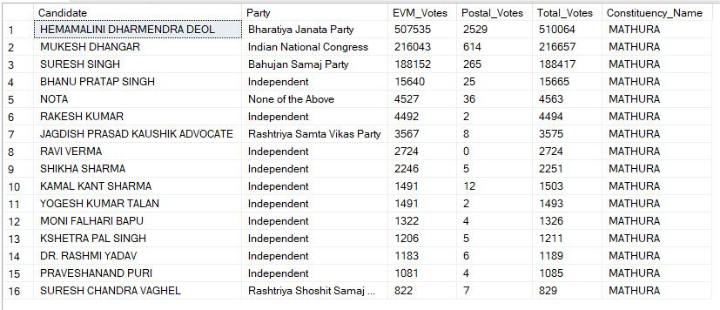
9. WHAT IS THE DISTRIBUTION OF EVM VOTES VERSUS POSTAL VOTES FOR CANDIDATES IN A SPECIFIC CONSTITUENCY?
Query
Result

Slide 13
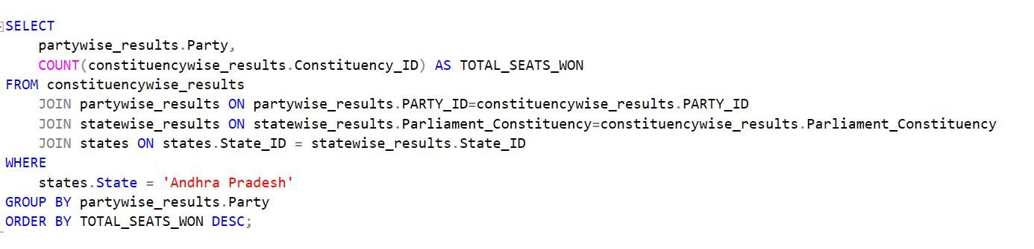
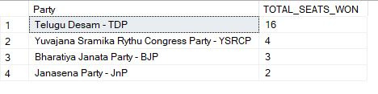
10. WHICH PARTIES WON THE MOST SEATS IN S STATE, AND HOW MANY SEATS DID EACH PARTY WIN ?
Query
Result

Slide 14
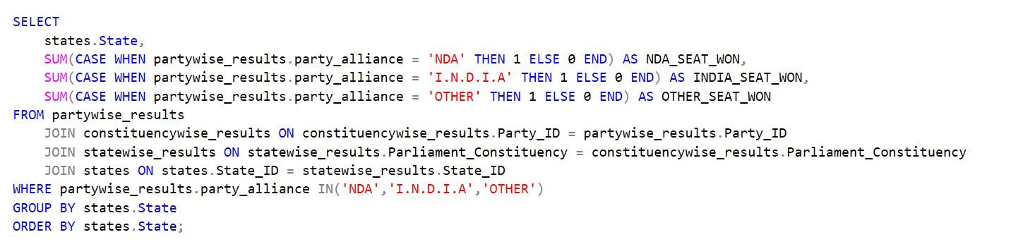
11. WHAT IS THE TOTAL NUMBER OF SEATS WON BY EACH PARTY ALLIANCE (NDA, I.N.D.I.A, AND OTHER) IN EACH STATE FOR THE INDIA ELECTIONS 2024
Query
Result Next Page

Slide 15
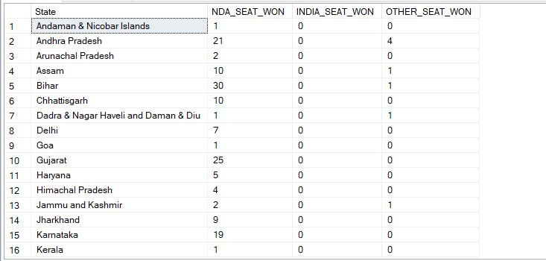
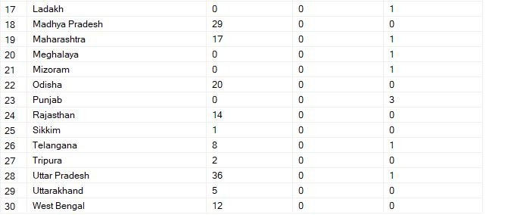
11. WHAT IS THE TOTAL NUMBER OF SEATS WON BY EACH PARTY ALLIANCE (NDA, I.N.D.I.A, AND OTHER) IN EACH STATE FOR THE INDIA ELECTIONS 2024
Result Page

Slide 16
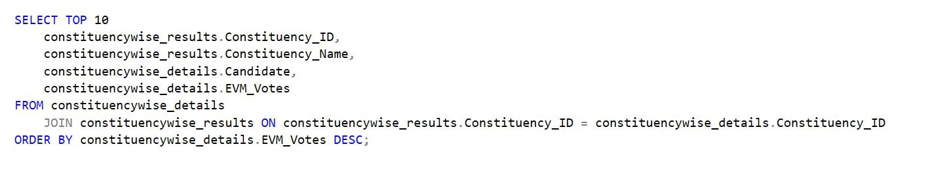
12. WHICH CANDIDATE RECEIVED THE HIGHEST NUMBER OF EVM VOTES IN EACH CONSTITUENCY (TOP 10) ?
Query
Result Next Page

Slide 17
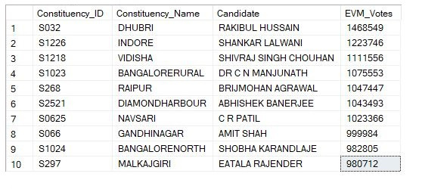
12. WHICH CANDIDATE RECEIVED THE HIGHEST NUMBER OF EVM VOTES IN EACH CONSTITUENCY (TOP 10) ?
Result Page

Slide 18
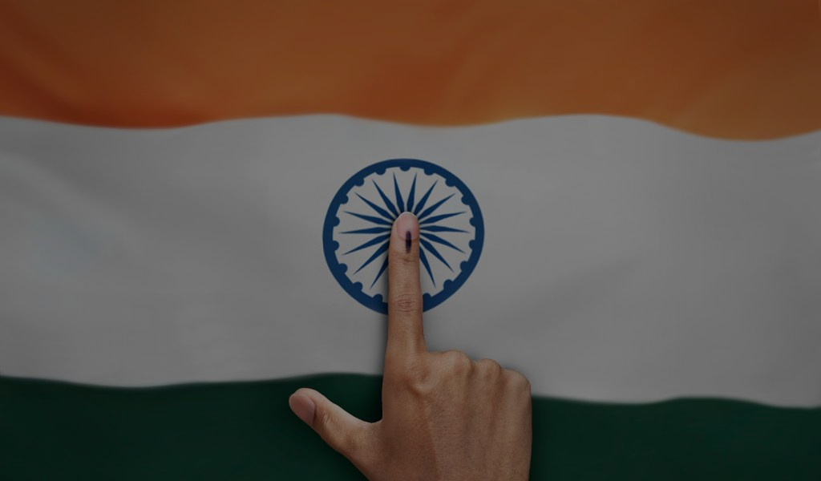
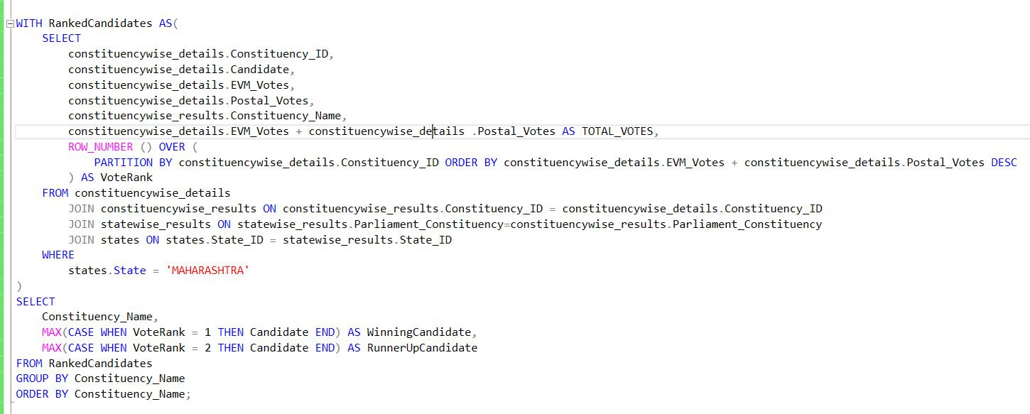
13. WHICH CANDIDATE WON AND WHICH CANDIDATE WAS THE RUNNER-UP IN EACH CONSTITUENCY OF STATE FOR THE 2024 ELECTIONS ?
Query
Result Next Page

Slide 19
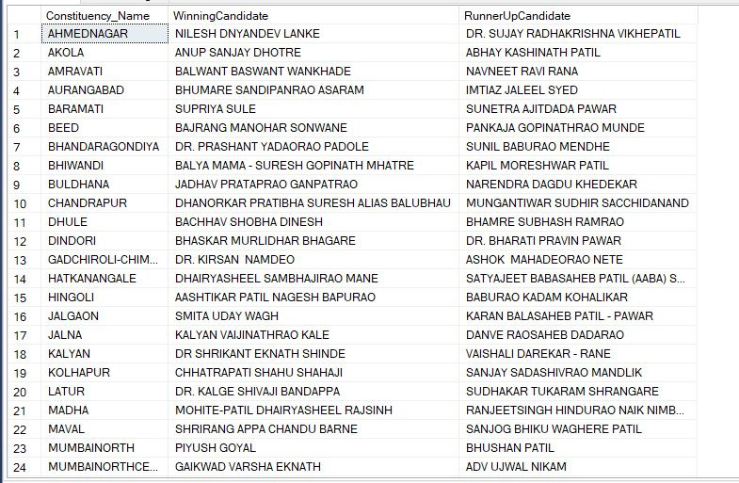
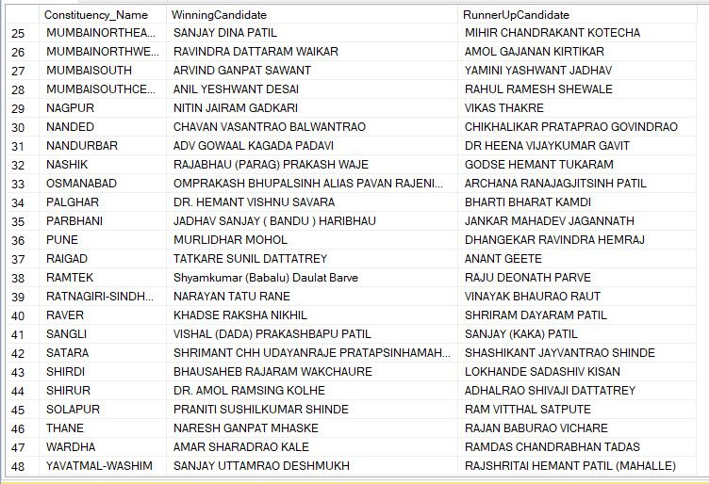
13. WHICH CANDIDATE WON AND WHICH CANDIDATE WAS THE RUNNER-UP IN EACH CONSTITUENCY OF STATE FOR THE 2024 ELECTIONS ?
Result Page

Slide 20
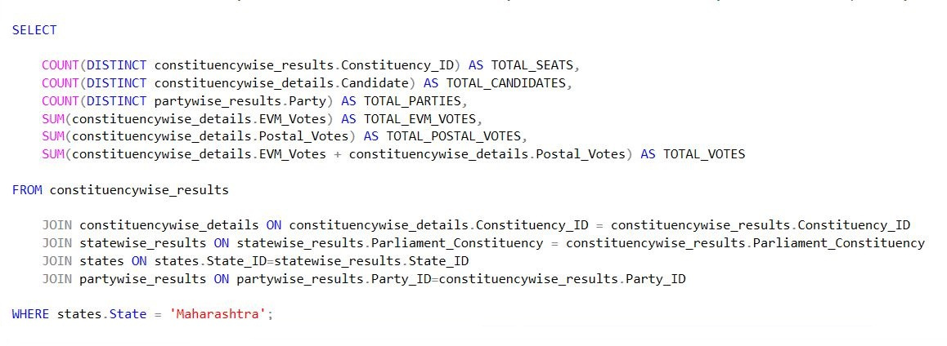
13. FOR THE STATE OF MAHARASHTRA, WHAT ARE THE TOTAL NUMBER OF SEATS, TOTAL NUMBER OF CANDIDATES, TOTAL NUMBER OF PARTIES, TOTAL VOTES (INCLUDING EVM AND POSTAL), AND THE BREAKDOWN OF EVM AND POSTAL VOTES ?
Query
Result Next Page

Slide 21
13. FOR THE STATE OF MAHARASHTRA, WHAT ARE THE TOTAL NUMBER OF SEATS, TOTAL NUMBER OF CANDIDATES, TOTAL NUMBER OF PARTIES, TOTAL VOTES (INCLUDING EVM AND POSTAL), AND THE BREAKDOWN OF EVM AND POSTAL VOTES ?
Result Page

Slide 22
THANK YOU
FOR COMING
CONTACT DETAILS
NAME - FAROOK MOHAMMAD
CONTACT - +91 9467671237
EMAIL - FAROOKMOHAMMD27@GMAIL.COM

